Slide 1
Evolving Needs, Adapting Services
Climate Emergency Summits:
Ideas Workshop

Slide 2
SUMMIT - a meeting or series of meetings between the leaders of two or more governments AIM Network intends to facilitate meetings between local government leaders to support regional efforts with climate mitigation activities to help reach local, provincial, federal and international climate change mitigation targets.
What is a climate summit?

Slide 3
Why do we need such a thing?
Local Action for Global Impact
One community acting alone has no effect
Lack of federal guidelines
Balancing costs with managing other assets
Lack of resources to make change

Slide 4
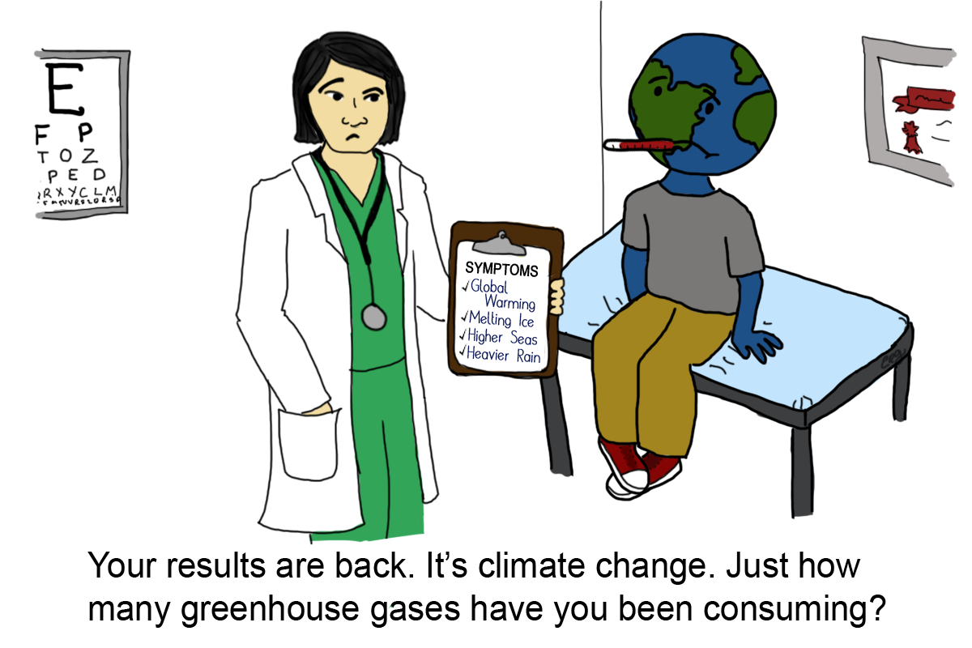
Adaptation versus Mitigation
Climate Adaptation – creating solutions (engineered, social, procedural, etc.) to maintain levels of service under long-term climatic change.
Climate Mitigation – creating solutions for the root causes of climate change.
Notes:
Matt Presents

Slide 5
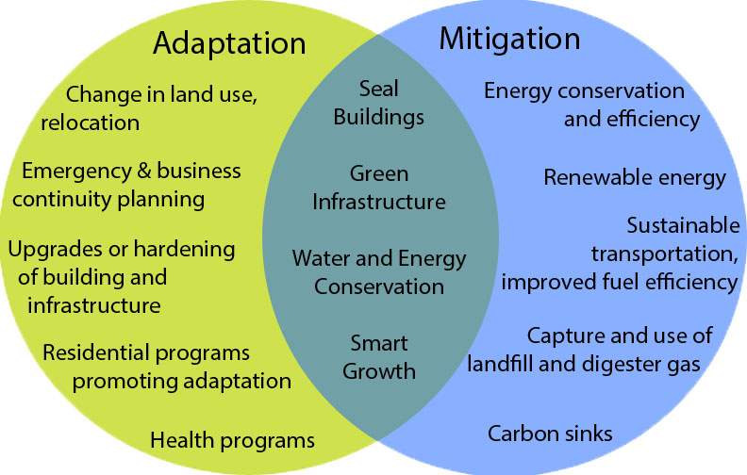
Adaptation versus Mitigation

Slide 6
Representative Concentration Pathway
RCPs usually refer to the portion of the concentration pathway extending up to 2100, for which Integrated Assessment Models produced corresponding emission scenarios. Extended Concentration Pathways (ECPs) describe extensions of the RCPs from 2100 to 2500 that were calculated using simple rules generated by stakeholder consultations, and do not represent fully consistent scenarios.
Notes:
Matt Presents

Slide 7
Representative Concentration Pathway
How much will we reduce emissions of gases that make climate change worse?
OR
What is the net change in heat in versus heat out?
Notes:
Matt Presents

Slide 8
Representative Concentration Pathway
RCP 2.5: “Low Carbon Future”, target of the Paris Climate Accord, unlikely to exceed 1.5 degrees compared to pre-industrial levels
RCP 8.5: Worst case scenario, likely to exceed 2.5 degrees and more likely than not to exceed 3.7 degrees compared to pre-industrial levels
With current action we will likely be somewhere in between those benchmarks IF we continue to increase mitigation action
Notes:
Matt Presents

Slide 9
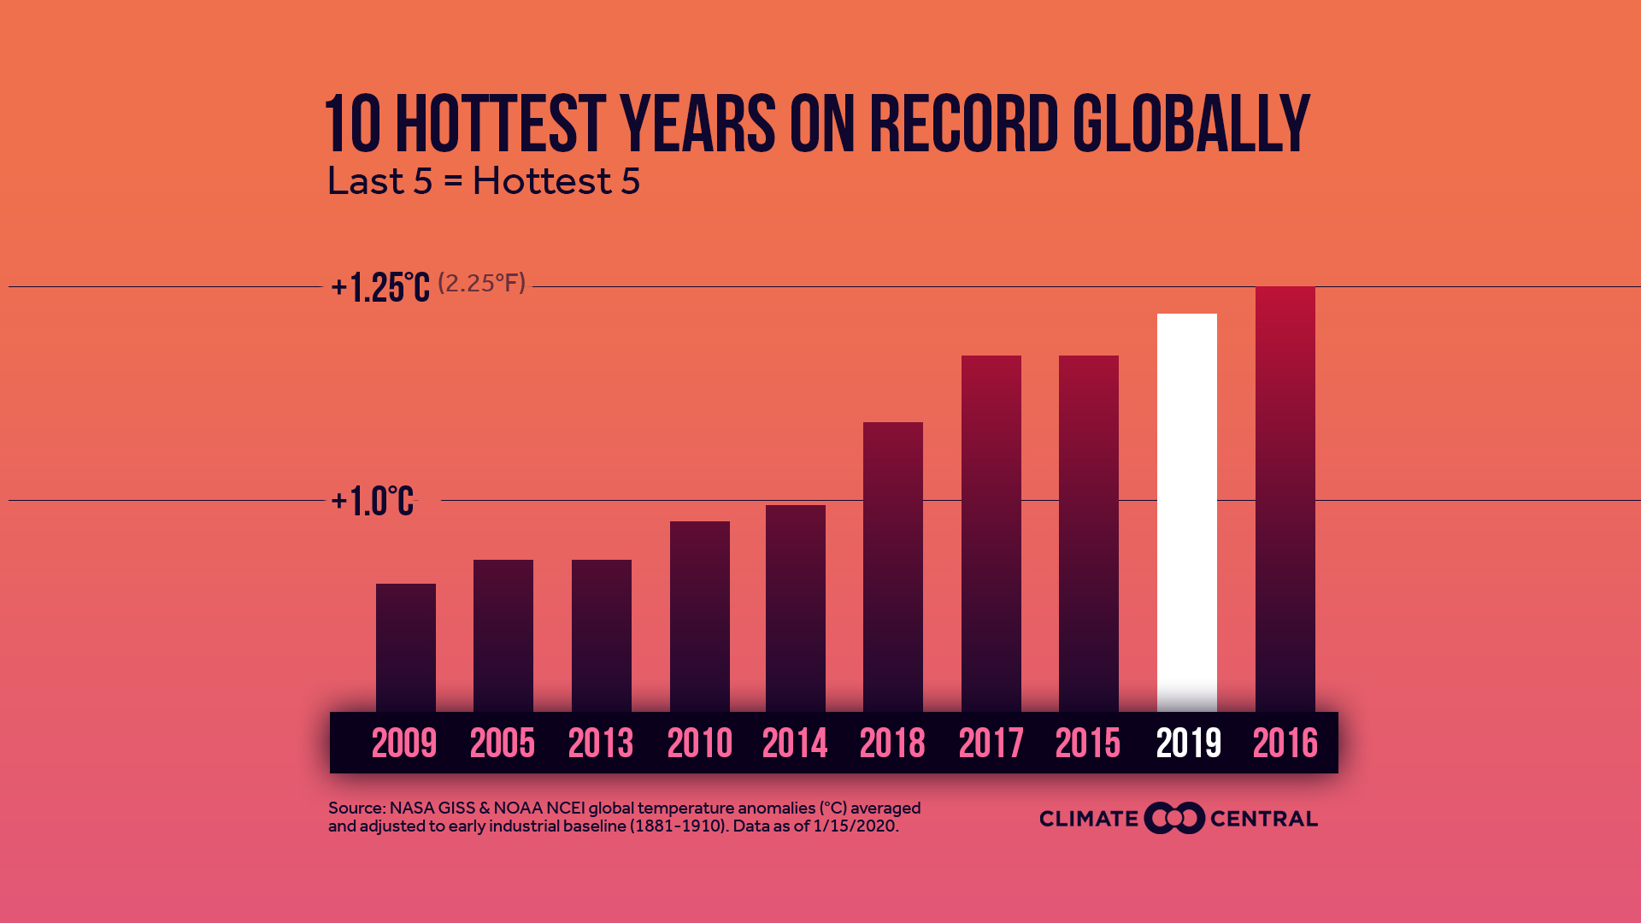
What is Failure? Look to Level of Service!

Slide 10
Anthropogenic Climate Change
Greenhouse gas (GHG) emissions:
Carbon Dioxide, Methane, Nitrous Oxide, Fluorinated Gases
Global Warming Potential (GWP):
Carbon Dioxide = 1, baseline
Methane = 28-36, 100 years
Nitrous Oxide = 265 – 298, 100 years
Fluorinated Gases = 10³-10⁴, 100 years
Notes:
Matt Presents

Slide 11
Measuring Climate Mitigation
Carbon Dioxide = 36 Billion tonnes
Methane = 570 Million tonnes
Notes:
Matt Presents

Slide 12
Municipal Climate Mitigation
44% of climate change emissions are under direct or indirect control of municipalities (FCM 2009)
26% of climate change emissions are from industry, half from the oil and gas sector.
YOU have the power!
Notes:
Matt Presents

Slide 13
Climate Mitigation and Asset Management
• Historically, climate mitigation was not considered an “Asset Management” activity
• The change in recent years stems from considering climate mitigation as critical to providing services in the long-term
• Many municipalities are starting to adopt policies that consider mitigation targets a key “level of service”

Slide 14
The Tragedy of the Commons
Tragedy of the commons:
Individual users with open access to a resource unhampered by social structures or formal rules act according to their own self-interest and, contrary to the common good of all users, cause depletion of the resource through uncoordinated action.

Slide 15
Action Plan
• Identify – What are my greenhouse gas sources? How much, how often?
• Assess – What can I do to mitigate? How much does it cost? What are the lifecycle costs and savings? What has the greatest return?
• Strategize – How will I fund the projects? When will I implement them?
• Manage – How will I monitor success? How will I adapt my plan to changing information and technologies?

Slide 16
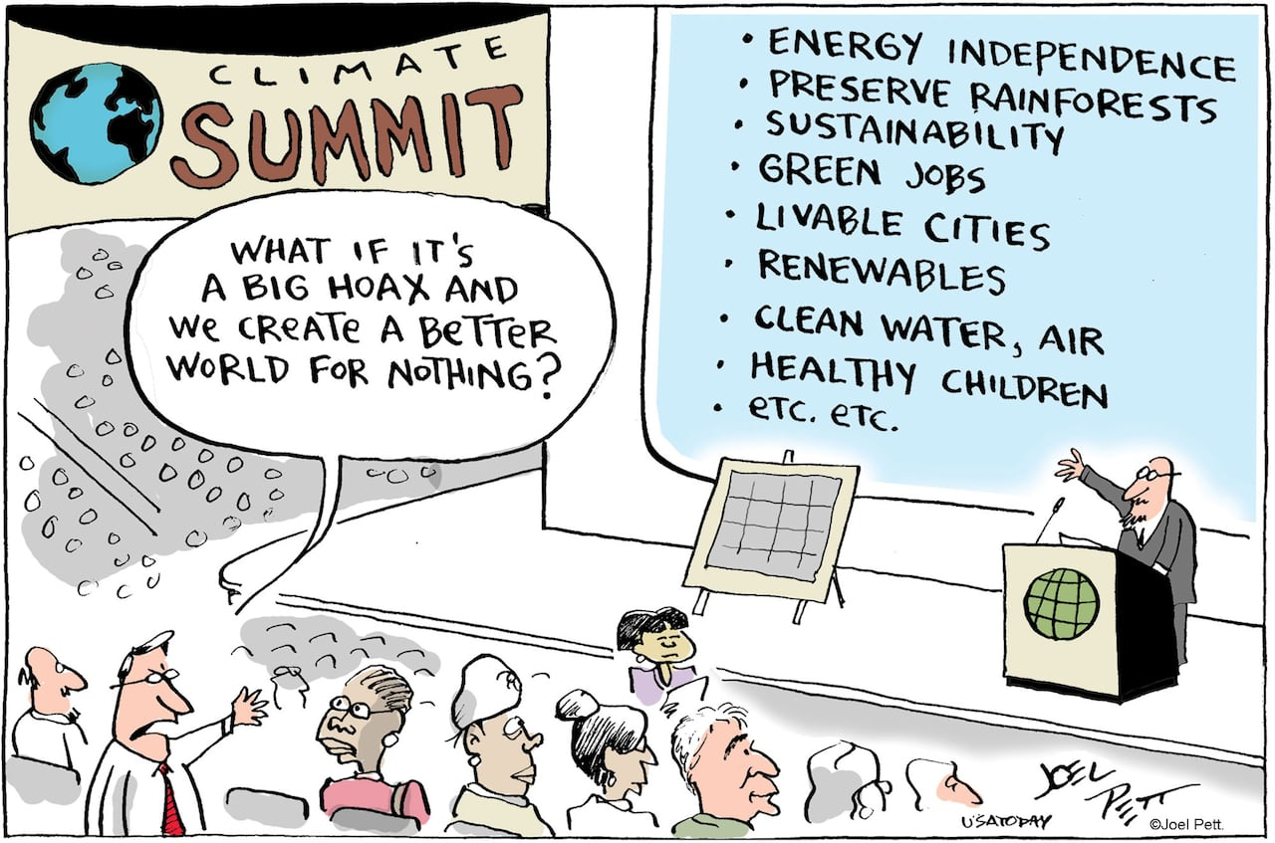
Asset Management Benefits
• Lower life-cycle cost of infrastructure
• Longer lifespan of infrastructure from lower run time and less aggressive run time
• More robust construction of building envelopes
• Increased levels of service
Co-Benefits
• Help avoid a global catastrophe
• Greater active transportation opportunities
• Improved community health outcomes
• Reduced air and water pollution

Slide 17
Discussion
Mitigation Action
Do you have a climate mitigation target (e.g. 30% below 2005 levels by 2030)
Is there support in your community for climate mitigation activities?
Are residents aware of the costs?
Are residents willing to pay a premium for climate friendly infrastructure?

Slide 18
Types of Mitigation
• Reduce electricity consumption
• Reduce emissions from vehicles
• Reduce greenhouse gas emissions as an industrial by-product
• Reduce life-cycle carbon footprint

Slide 19
Reduce Electricity Consumption
• How much power generation is “non-emitting”?
• How much should energy consumption be pro-rated?
• Are any activities exempt from pro-rating energy basis?
• Energy projects should focus solely on measures with defined co-benefits

Slide 20
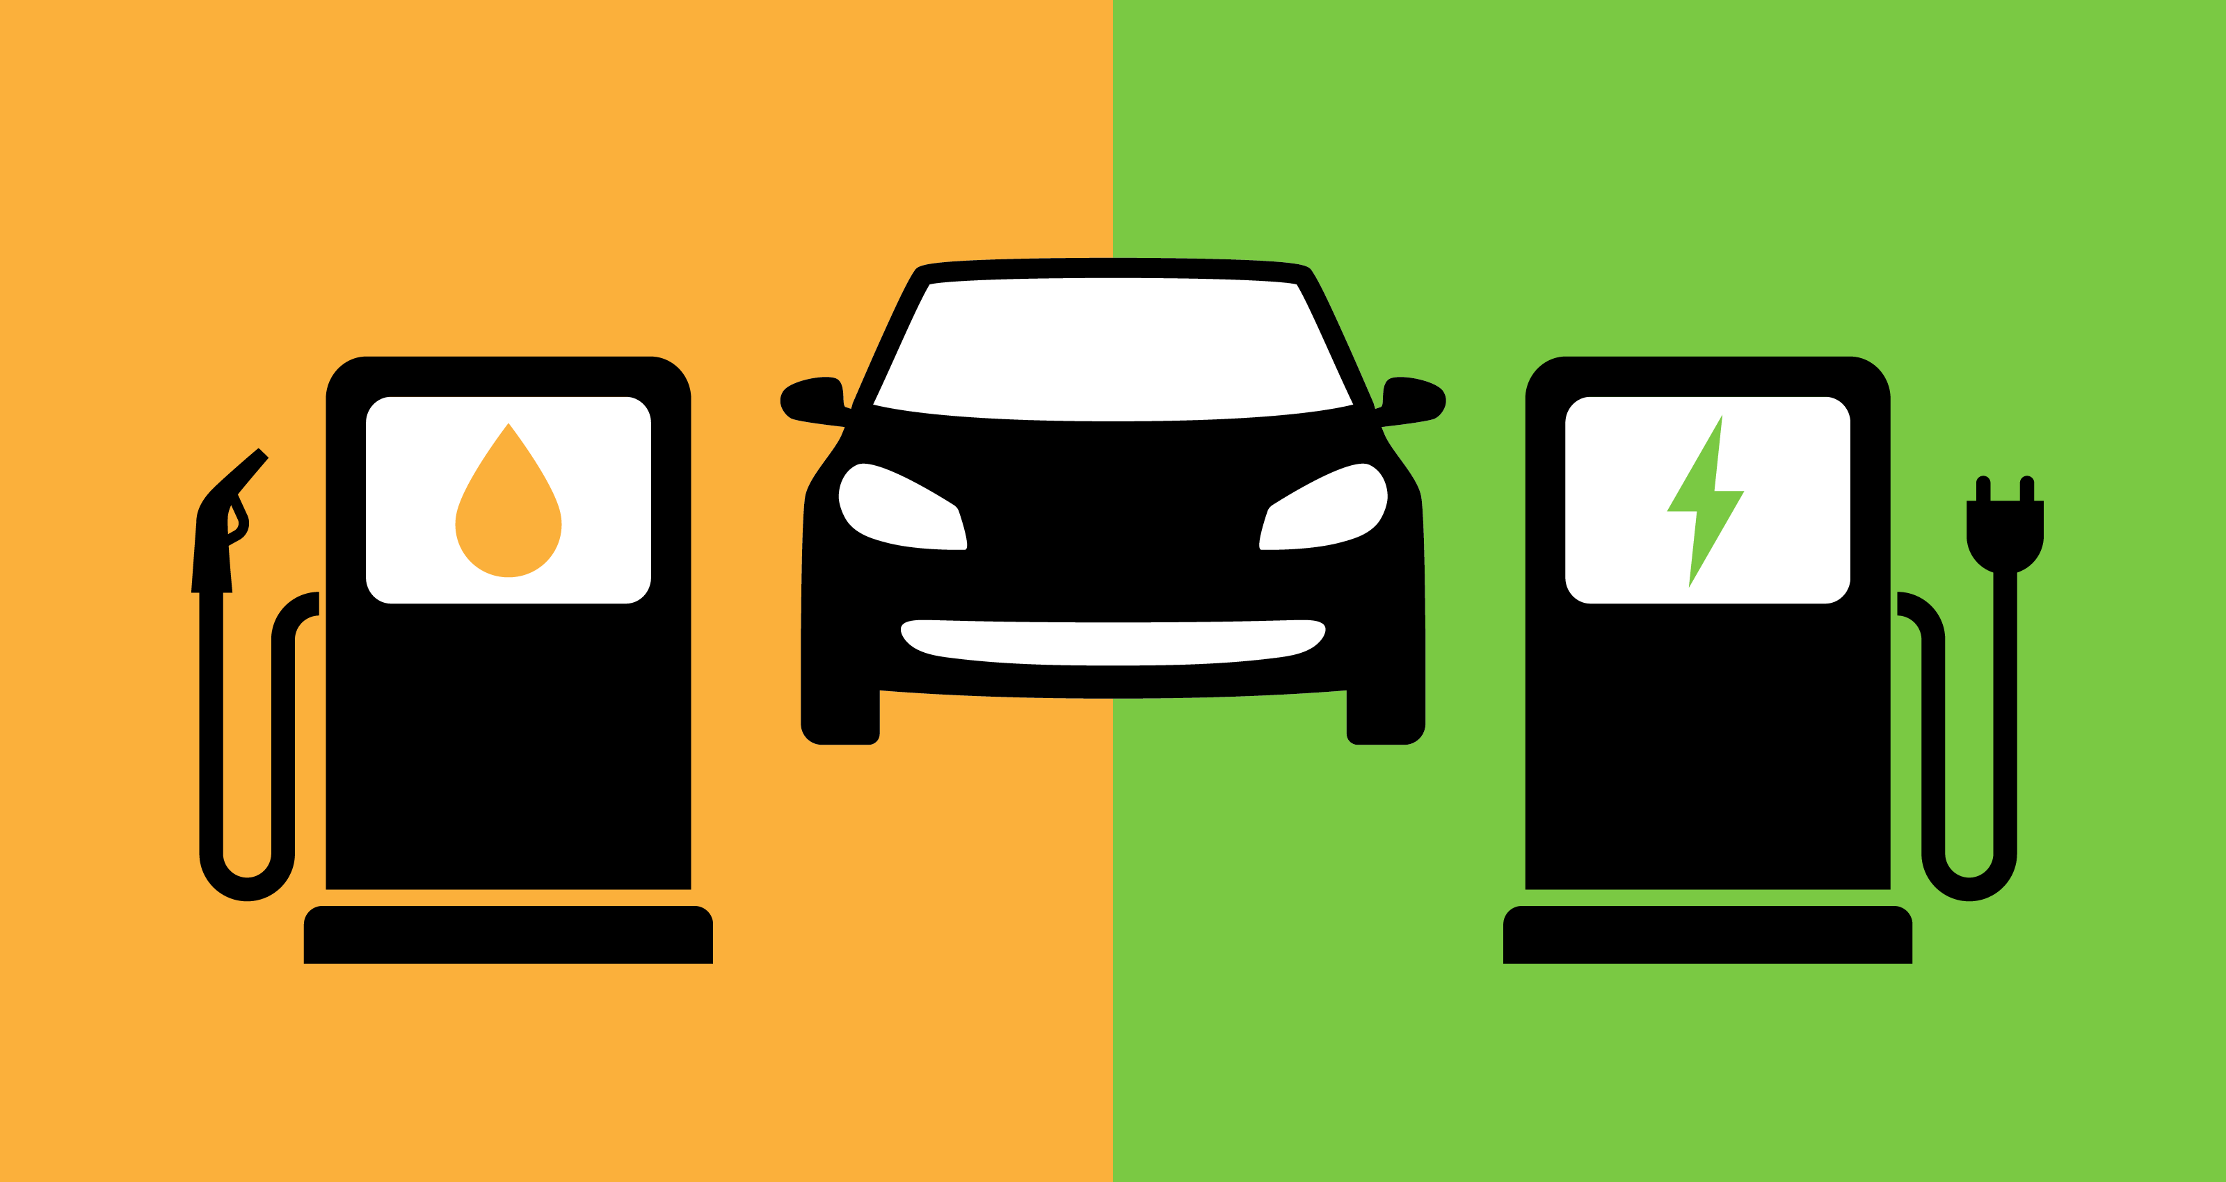
Reduce Vehicle Emissions
• Direct action: change municipal fleet vehicles to electric
• Indirect action: support community change to low emission vehicles

Slide 21
Reduce Vehicle Emissions
• Need to consider the equivalent tonnes of CO2 (kgCO2e)
• Electric vehicles
- are they powered from the grid?
- is the grid power from renewable sources?
- can you draw power off-peak to use renewable power?
- hybrids will retain a mix of emission profiles
• Sometimes it is easiest to convert units for consistent comparisons:
kWh → kgCO₂e →km drive time → hours of operation

Slide 22
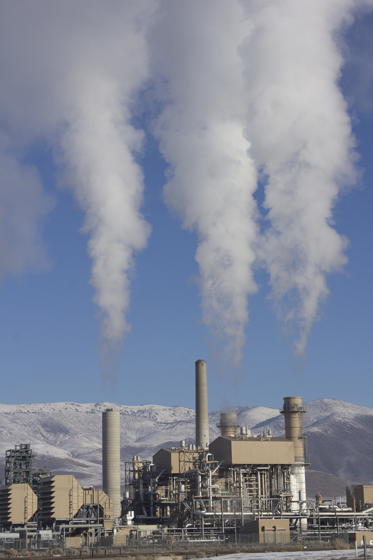
Reduce Industrial By-Product Emissions
• What types of industry do you have?
• How can you encourage action from private industry?
• Bylaws (the stick)
• Funding (the carrot)
• Procurement policies
• Education
• Economic development plans

Slide 23
Reduce Life Cycle Carbon Footprint
• Operations and Maintenance Activities
• Carbon footprints of materials
• Carbon sequestration
• Building practices
• Extend useful life of infrastructure

Slide 24
What are the benefits of a regional approach?
Information sharing and knowledge mobilization
Collaboration on joint projects
Sharing tools, templates, human resources
Developing purchasing groups for cost sharing
?????

Slide 25
What would this look like?
Facilitated kickoff meeting with “Anchor Municipality”, program development
Recruit summit partners
Climate Emergency Summit (All Stakeholders)
Partner debrief workshop – draft plans, terms of reference, agreements, roadmaps, etc.
Finalize governance documents and action plan
Final consultation workshop and action plan kickoff

Slide 26
Activity
Consultation Partners

Slide 27
Activity
Barriers to Mitigation Projects

Slide 28
Activity
Opportunities

Slide 29
Activity
Discussion

Slide 31
Carbon Equivalencies
Not all kWh are Equal! Need to use Energy Conversion Factors

