Slide 1
AIM Network 2021 Asset Management Conference Level of Service Workshop

Slide 2
Workshop Facilitator
Matt Delorme, P. Eng
Technical Program Manager
AIM Network

Slide 3
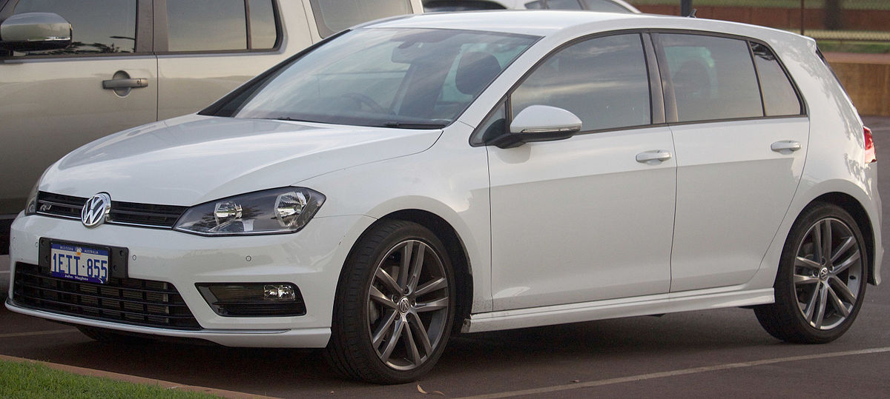
What Are Levels of Service?
LOS are specific parameters that describe the extent and quality of services that the municipality provides to users.
Lambo? or VW?

Slide 4
Corporate Strategic Context
Levels of Service Support Strategic Goals
Comply with legal requirements
Protect public safety and the environment
Achieve strategic plan objectives
Align with community plans, growth strategies or sustainability strategies, infrastructure master plans
Consider recent planning processes that involved the public:
Was the public adequately informed?
What did the public expect?
What commitments were made?

Slide 5
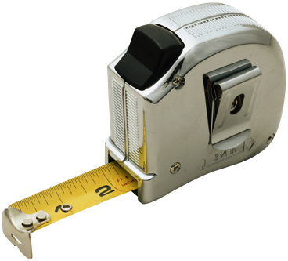
Levels of Service Reporting
Purpose
to facilitate communication with Council, stakeholders and the public on:
Services and LOS the municipality provides
Gaps between current and expected LOS
Actions and estimated resource needs to address gaps

Slide 6
Levels of Service Template – Seven Steps
Process:
Identify your Services
Identify your Assets
Describe Current Levels of Service
Identify Performance Measures
Identify Performance Gaps
Develop Strategies to Address Gaps
Prepare a Service Delivery Plan
1
2
3
4
DEFINING
7
6
5
ASSESSING

Slide 7
Levels of Service Template
Template Structure: Four Worksheets
Introduction
Services and Assets
Describing Levels of Service
Describe the services your municipality provides, and the assets it owns
Document your municipality’s current service commitments
Reporting Out
Identify performance measures and service level gaps
Identify potential strategies to address the gaps, including “do nothing”
Compare the potential strategies and select a preferred strategy for planning
Create an Action Plan timeline for required activities

Slide 8
Service Characteristics
General properties that may be used to describe a service:
Regulatory: What is the legal minimum?
Capacity/Availability: How much, where, when and for whom?
Safety: Protecting people and property
Quality: How good is it (and in what respect)?
Reliability: How often is service interrupted?
Sustainability: How well is the environment protected?

Slide 9
Current Performance Gaps
Are there gaps between current performance and LOS goals?
Too low, or too high?
How can gaps be addressed?
Reduce service level commitment
Change O&M practice
Manage demands
Acquire or improve assets
Consult Council and the public

Slide 10
Sustainability Gaps
Are there foreseeable future gaps between current performance and LOS commitments?
Consider:
Community growth and demographic change
New development plans
Legislative Changes

Slide 11
Options to Address Gaps
Describe the Options. Consider:
Master Plans: Have options previously been developed and costed?
Are there ways to meet the community’s need without new infrastructure?
Is doing nothing acceptable?
What level of public or stakeholder communication is needed?
What are the best solutions?
Which options are feasible?
Which options are affordable?
What option has the lowest lifecycle cost?
What are the implications for risk over the asset life cycle?
Document lifecycle cost implications.
Make a recommendation.

Slide 12
Activity
Level of Service

Slide 13
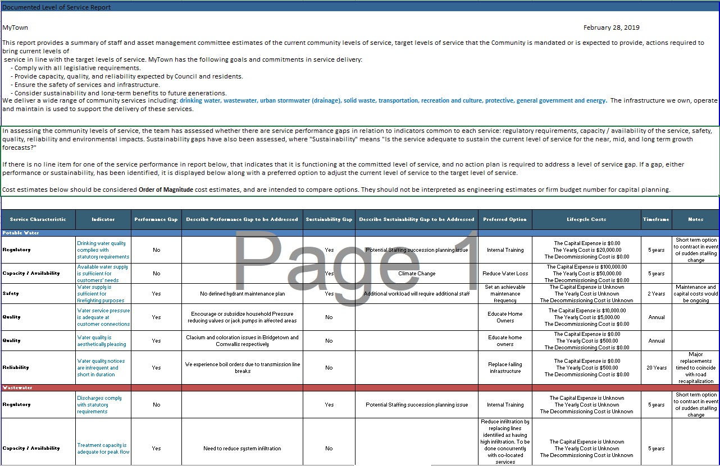
Template: Reporting Out

