Slide 1
AIM Network 2021 Asset Management Conference
Geological Hazard Vulnerability Assessments in
Two Newfoundland Towns
MW & Associates Inc.

Slide 2
OUTLINE
Our team
What are GeoHazards?
Climate Change
Some common GeoHazards
Why consider them?
Assessment methods
Multi-Hazard mapping for Conception Bay South and Ferryland (NL)
What next?

Slide 3
Martin Batterson, Ph.D., P.Geo.

Slide 4
Karl Keough, M.Sc., MES

Slide 5
Michel Wawrzkow, P.Eng., P.Geo.

Slide 6
What are GeoHazards?
They are those hazards that have a geological component and include flooding and mass movements, commonly on steep (>20°) slopes.

Slide 7
EXAMPLES
Slope Failures
Rock falls
Landslides
Avalanches
Sinkholes
Coastal erosion
Coastal flooding
Storm surges
Inland flooding
Tsunamis
Earthquakes
Volcanoes
Exacerbated by Climate Change

Slide 8
why CLIMATE CHANGE ?????
It’s all about
Climate projections indicate It will generally get wetter throughout Atlantic Canada because of Climate Change!
Sea levels are rising
Annual precipitation will increase
Storms will be more frequent and intense
More rain-on-snow events
HOWEVER…
“Atmospheric River”,
“Weather Bombs”, etc

Slide 9
CLIMATE CHANGE…
…can bring more forest fires and periods of drought
that will cause loss of vegetation (decreased evapotranspiration)
which can increase groundwater levels and surface runoff during wet periods
which can make land more vulnerable to GeoHazards!

Slide 10
Types of Slope Failures
A) Bedrock (undercutting by erosion)
B) Bedrock (toppling)
C) Bedrcok (sliding)
D) Soil (rotational slump)
E) Soil (creep)
F) Soil (debris flow)

Slide 11
Rock Toppling/Sliding, St John’s (NL) Pitts Memorial Drive (Nov 2021)

Slide 12
Rotational Slump, Daniels Harbour (NL) April 2007

Slide 13
Landslide, Harbour Breton (NL) August 1973

Slide 14
Historic slope failures in
Atlantic Canada

Slide 15
… and Avalanches too!!

Slide 16
SINKHOLES Rideau Street (Ottawa) and Codroy Valley (NL)
Sources: CBC News Memorial University (Trevor Bell)

Slide 17
SINKHOLES in karst topography
Source: NS Energy and Mines

Slide 18
Karst Risk Map (NS)
Source: NS Energy and Mines

Slide 19
Coastal Erosion Admiral’s Beach (NL)
Source: Geological Survey of NL

Slide 20
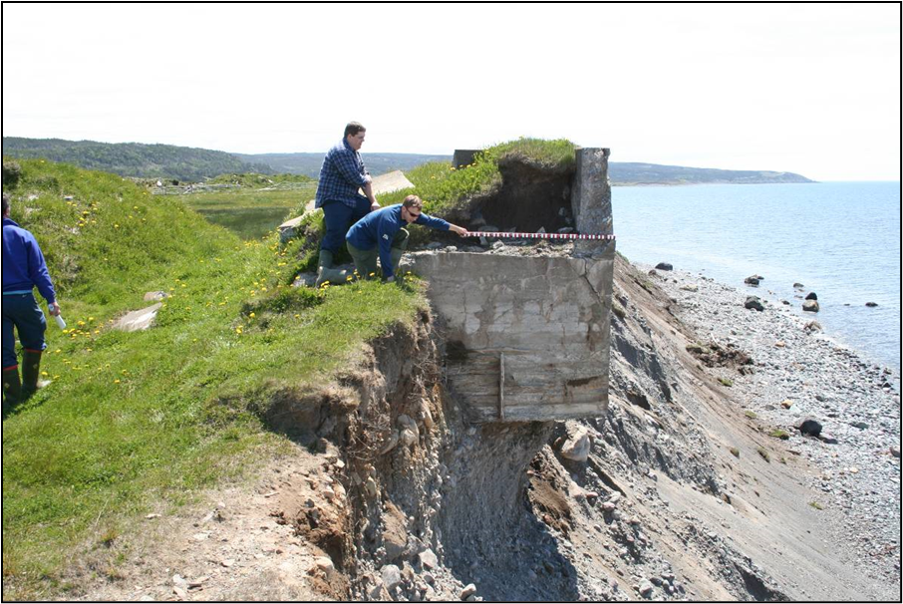
Coastal Erosion Pointe Verde (NL)
1999
2005
Source: Geological Survey of NL

Slide 21
Coastal Sensitivity to Sea Level Rise Atlantic Canada
Source: Natural Resources Canada

Slide 22
STORM SURGE Ferryland(NL) during Hurricane Larry, October 2021
Source: Colony of Avalon Facebook

Slide 23
TSUNAMI – St Lawrence (NL) 1929 Grand Banks Earthquake
Sources: Geological Survey of NL; Natural Resources Canada

Slide 24
So, what do GeoHazards and Climate Change have to do with Asset Management ????

Slide 25
“The purpose of Asset Management is to ensure Sustainable Delivery of Services, by managing service, cost, and risk. “
Source: Climate Risk Institute, Infrastructure Resiliency Professional credentialling program

Slide 26
Climate Change Risk Assessment
Asset Management
Resilient Infrastructure
&
Sustainable Service Delivery

Slide 27
In view of the potential for catastrophic outcomes of geological disasters on municipal service delivery, GeoHazard considerations
should be key inputs to
Climate Change Risk Assessments

Slide 28
Risk Matrix

Slide 29
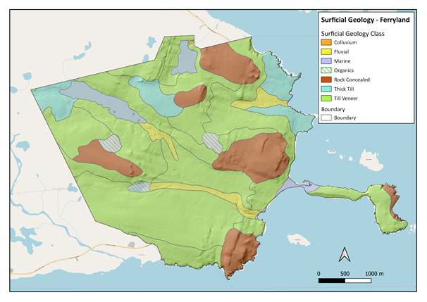
METHODS Step 1: Surficial Geology (i.e. soils over bedrock)

Slide 30
METHODS Step 2: Bedrock Geology

Slide 31
METHODS Step 3: Digital Elevation Model

Slide 32
METHODS Step 4: Slope Classification

Slide 33
METHODS Step 5: Elevation Classification

Slide 34
METHODS Step 6: Map Historical Geological Events

Slide 35
METHODS Step 7: Apply a Factor Score…
LAYER | FACTOR SCORE
Slope (0 - 20.00°) | 1
Slope (20.01° - 45.00°) | 5
Slope (> 45.01°) | 10
Historical Occurrence | 10
Within 20-year flood zone | 10
Within 100-year flood zone | 5
Below 2 m asl | 10
Between 2 m and 4 m asl | 5
Within 20 m (protected coast) or 40 m (exposed coast) of edge of cliff composed of unconsolidated sediment. Includes adjacent cliff. | 10

Slide 36
METHODS …to create a Multi-Hazard Vulnerability Map

Slide 37
Conception Bay South (NL)

Slide 38
So, what does a town do with this info???
Land Use Planning/Development Control
Require developers to undertake site-specific geological/geotechnical investigations in areas identified as being vulnerable to GeoHazards.
Support successful applications for government funding (e.g. MAMP, ICIP, etc)
Effective, proactive management of its engineered and natural assets.

Slide 39
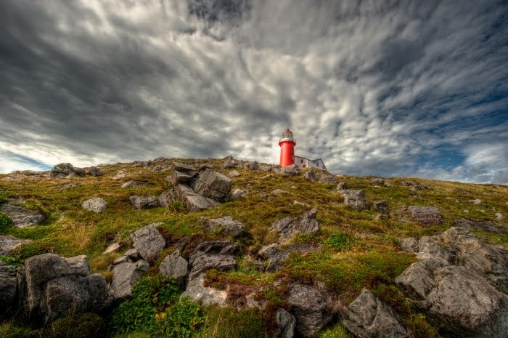
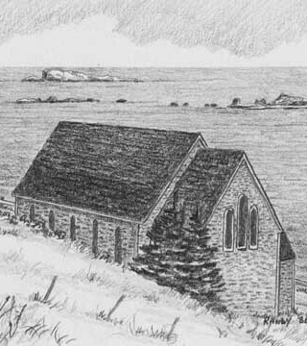
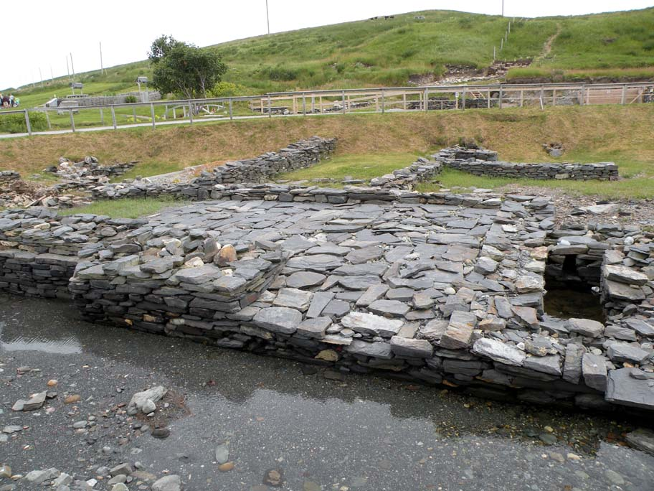
QUESTIONS?
Pictures of Ferryland, NL (source: Google)

Slide 40
THANK YOU!
Michel Wawrzkow, P.Eng, P.Geo.
Principal Geological/Environmental Engineer and Geoscientist
MW & Associates Inc.
6 Stoneyhouse Street, St John’s (NL), A1B 2T6
mwawrzkow@bellaliant.net
709-730-4155

